Slide 1
Data Viz Challenge
Agenda:
Raw Data Ingestion & Preliminary Analysis
Data Quality Checks & Data Cleaning
Dashboard Creation
Next Steps
1

Slide 2

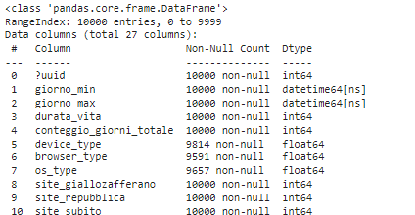
Raw Data Ingestion & Preliminary Analysis
Retrieve data from CSV datasets.
Analysis of datasets structure
Corrective actions:
Import date fields in a datetime format
Split “prima_citta” columns in two different fields in order to separate country code from city code
Trasform float datatype into an integer datatype
2

Slide 3
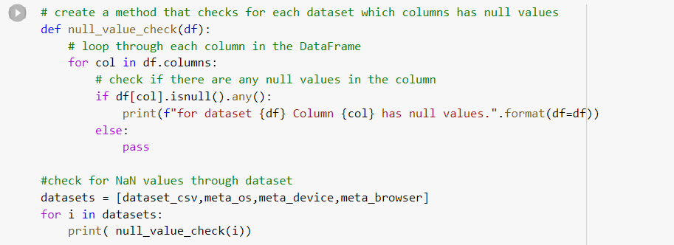
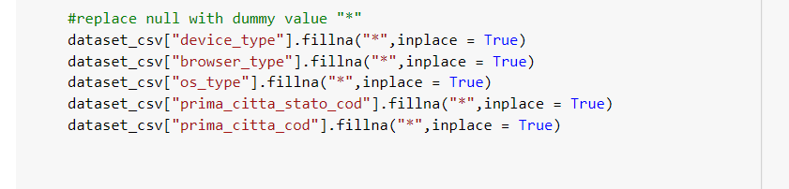
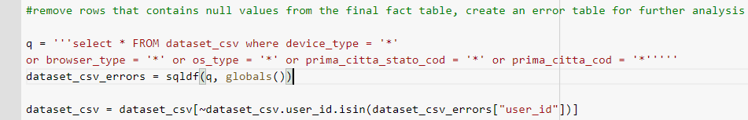
2. Data Quality Checks & Data Cleaning (1/2)
Scan for columns containing Null values
Replace Null values with a dummy value (“*”)
Remove rows with at least a null value and put them into an Error Tabel (dataset_csv_errors)
3

Slide 4
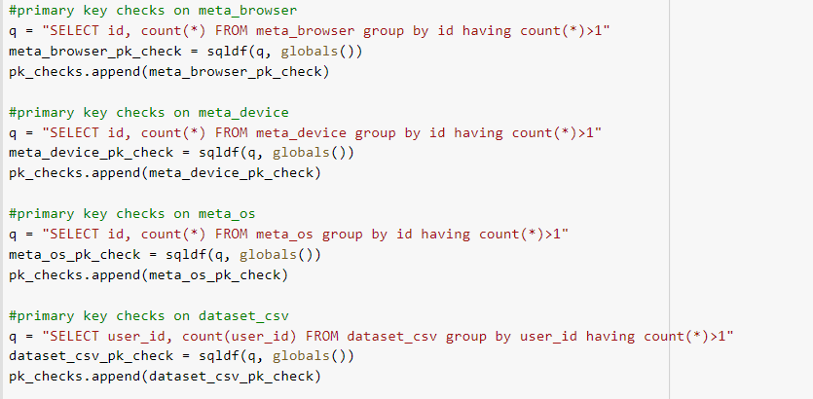
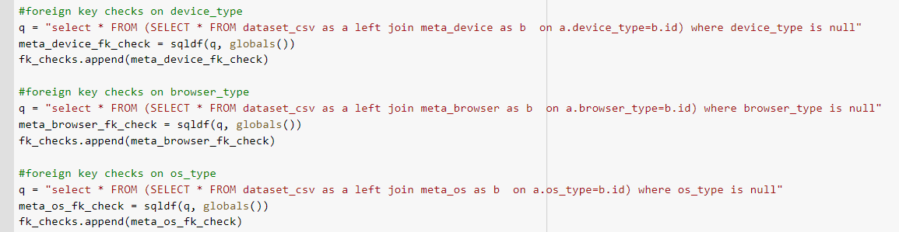

2. Data Quality Checks & Data Cleaning
Perform primary key checks
Perform foreign key checks
Download final datasets
4

Slide 5
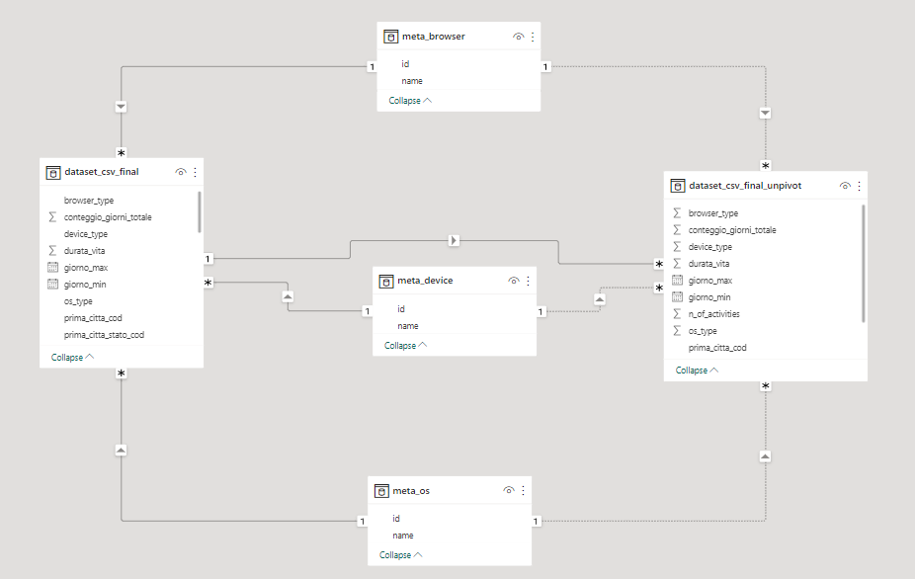
3. Dashboard Creation (1/5)
Import datasets on power BI
Create Relations and Data Model
Create measures and calculated columns
Create visualizations
5

Slide 6
3. Dashboard Creation (2/5)
Create dashboards structure: the dashboard will be divided into three dimension of analysis (Device, Os, Browser)
Device: We would like to know how users’ activities are distributed through different devices. We would also know how active days and life duration changes from a device to another
OS: We would like to know how activities are distributed through different OS
Browser: We would like to know how activities are distributed through different browsers
Create measures and calculated columns
6

Slide 7
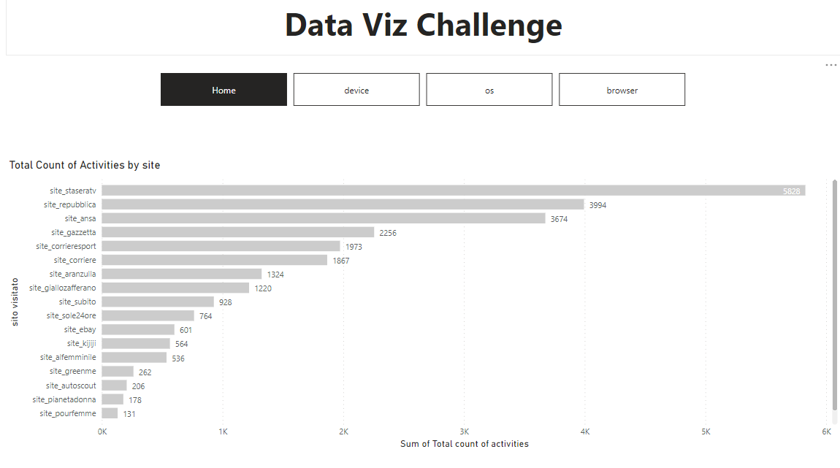
3. Dashboard Creation (3/5)
Create visualizations
Home Page
7

Slide 8
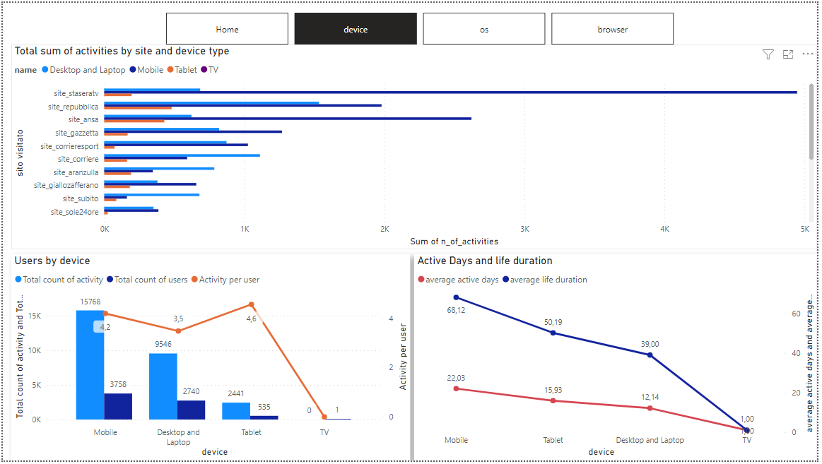
3. Dashboard Creation (4/5)
Create visualizations
Device
8

Slide 9
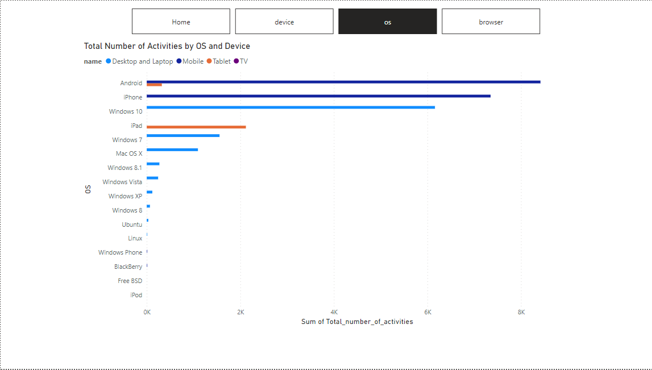
3. Dashboard Creation (5/5)
Create visualizations
OS
9

Slide 10
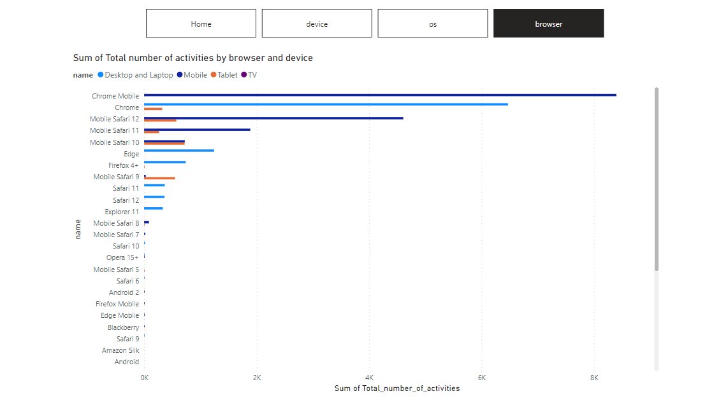
3. Dashboard Creation (5/5)
Create visualizations
Browser
10

Slide 11
4. Next Steps
We can include these features in the second release:
Since we have the city detail for each user, we can create a visualization that distribute users/actions on a map.
We can create more KPIs for OS and Browser dimension.
11

